Slide 1
Emissions data & coding in R
William Lamb

Slide 2
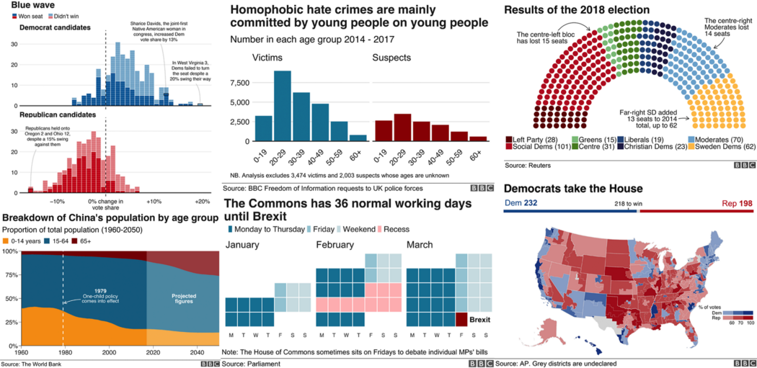
Why do it?
Coding is completely flexible
Has a strict workflow: reproducible
Can produce publication ready figures and analysis
Transferrable skill

Slide 3
Introduction
R is free & you can download it and get started easily
It has a large development and support community
If you get stuck, google usually helps
You will also need to get used to looking up syntax (use the “help” window in Rstudio)
We will use tidyverse – a set of packages that help to manipulate and plot data
There are hundreds of tidyverse guides and videos online
We will use Rmarkdown workbooks to organize the workflow

Slide 4
To do
Install R: https://www.r-project.org/
Install R studio: https://www.rstudio.com/products/rstudio/download/
Download the R project I started: https://github.com/lambwf/Data-perspectives-on-global-greenhouse-gas-emissions-course
Run “packages.R” to install tidyverse and other packages we need

Slide 5
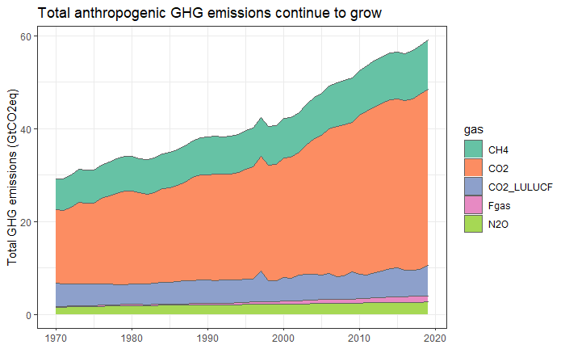
How a data pipeline looks
plot_data_gases <- gather(plot_data_gases,key="gas",value="total_GHG_emissions",CO2:CO2_LULUCF)
plot_data_gases <- plot_data_gases %>%
filter(year!=2020) %>%
mutate(total_GHG_emissions=total_GHG_emissions/1e9))
ggplot(plot_data_gases,aes(x=year,y=total_GHG_emissions,fill=gas)) +
geom_area(color="#636363") +
ylab("Total GHG emissions (GtCO2eq)") +
theme_bw() +
scale_fill_brewer(palette="Set2") +
theme(axis.title.x = element_blank()) +
ggtitle("Total anthropogenic GHG emissions continue to grow")
library(tidyverse)
library(readxl)
data_ghg <- read_excel('Data/essd_ghg_data_gwp100.xlsx', sheet = 3)
data_lulucf <- read_excel('Data/essd_lulucf_data.xlsx', sheet = 2)
plot_data_gases <- data_ghg %>%
group_by(year) %>%
summarise(CO2=sum(CO2,na.rm=TRUE),
CH4=sum(CH4,na.rm=TRUE),
N2O=sum(N2O,na.rm=TRUE),
Fgas=sum(Fgas,na.rm=TRUE))
plot_data_lulucf <- data_lulucf %>%
group_by(year) %>%
summarise(CO2_LULUCF=sum(mean,na.rm=TRUE))
plot_data_gases <- left_join(plot_data_gases,plot_data_lulucf,by="year")

Slide 6
Key coding concepts in R Tidyverse
Data frames
Functions
Libraries
Piping
Grouping
Joining
Reshaping
Mutating
Filtering
Plotting

Slide 7
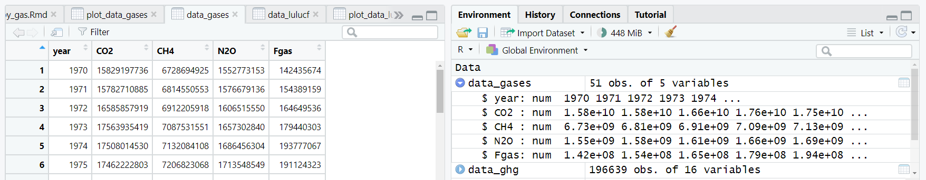
Data frames I
The basic data format in R, much like a spreadsheet
You can click on data frames in the environment window to open them and see what is going on
Do this often!

Slide 8
Data frames II
Each column of data has a given format
We will mostly use “numerical” and “factor” formats
When working with data, there is an important difference between 0 values and NA
0 means nothing of something
NA means this observation is missing
Many databases online have strange or ambiguous NA designations (“-”)
If you sum up a column of observations with NAs, you will get NA. Use “na.rm=TRUE” to avoid this

Slide 9
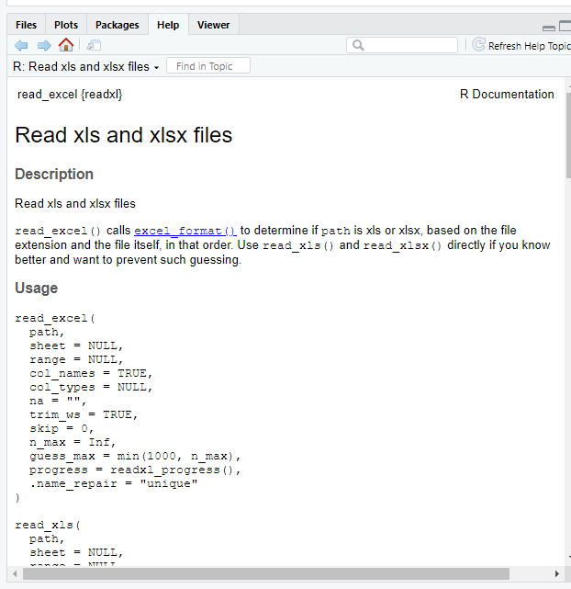
Functions
Coding is mostly applying a sequence of functions to manipulate and transform your data
Today we are using: read.xlsx(), group_by(), summarise(), sum(), left_join(), gather(), ggplot(), geom_area()
Functions have a syntax: you have to give them information in a certain order, or explicitly tell them what you are giving
data_ghg <- read_excel('Data/essd_ghg_data_gwp100.xlsx',sheet=3)
the path the the file and the sheet that should be read
You can look up the syntax in the help window ->
Or by typing ?function_name() in the command line

Slide 10
Libraries
Libraries are packages of functions supported by the development community
Tidyverse is a library
You can install a library easily by typing in the command line
install.packages('tidyverse')
Then you need to load it at the beginning of your script
library(tidyverse)

Slide 11
Piping
Problem: most coding involves a sequence of multiple actions, how can we keep these visually and conceptually clear?
plot_data_gases <- data_ghg %>%
filter(year>=1990) %>%
mutate(CO2=CO2/1e9)
Is the same as…
plot_data_gases <- filter(plot_data_gases, year>=1990)
plot_data_gases <- mutate(plot_data_gases, CO2=CO2/1e9)
<- writes the final output to this object
%>% is the pipe which sends the output of the previous operation forwards
Use the shortcut! Ctrl + Shift + M

Slide 12
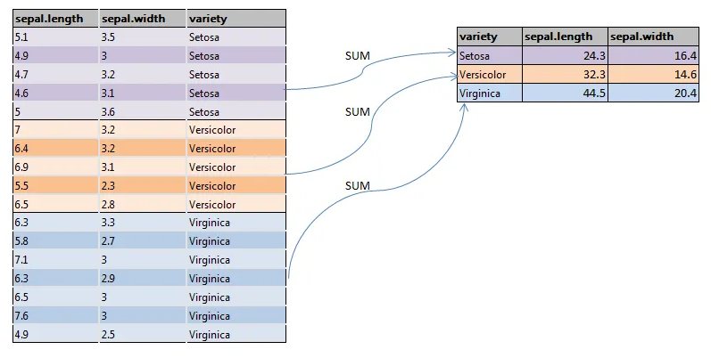
Grouping
Problem: data is not at the right level of aggregation
Years x sectors x countries x gases
How to get years x gases?
Use “group_by” then “summarise”
plot_data_gases <- data_ghg %>%
group_by(year) %>%
summarise(CO2=sum(CO2,na.rm=TRUE))
Using the “summarise” operation means you “lose” data (e.g. emissions by countries and sectors), so you should save it into a new variable

Slide 13
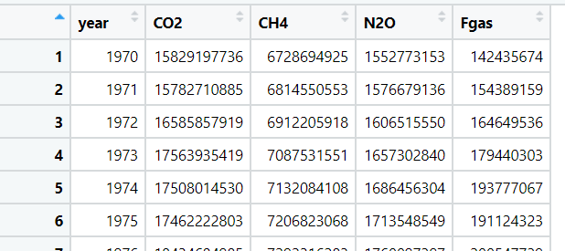
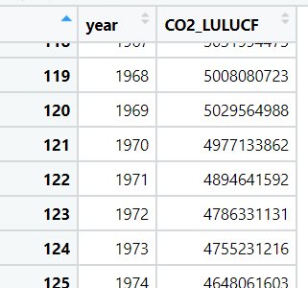
Joining I
Problem: we have two data frames sourced from different datasets. We need to join these together to compare and plot the data
To perform the join, we need a matching variable(s). Here we can use “year”.

Slide 14
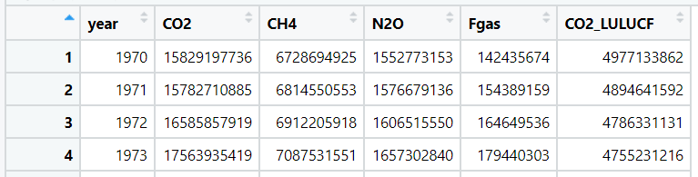
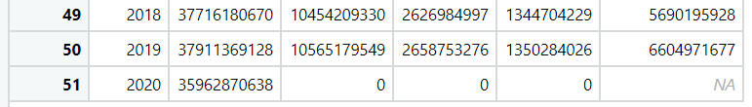
Joining II
There are different join functions. Here we can use “left_join”, which preserves the “left” data frame and matches rows in the “right” data frame to it using the year column
plot_data_gases <- left_join(plot_data_gases,plot_data_lulucf,by="year")
Because we did a left_join, all rows in the right data frame that don’t fit into the left are discarded (e.g. 1850-1969)
And if the right data frame doesn’t have a matching row, it gets an NA

Slide 15
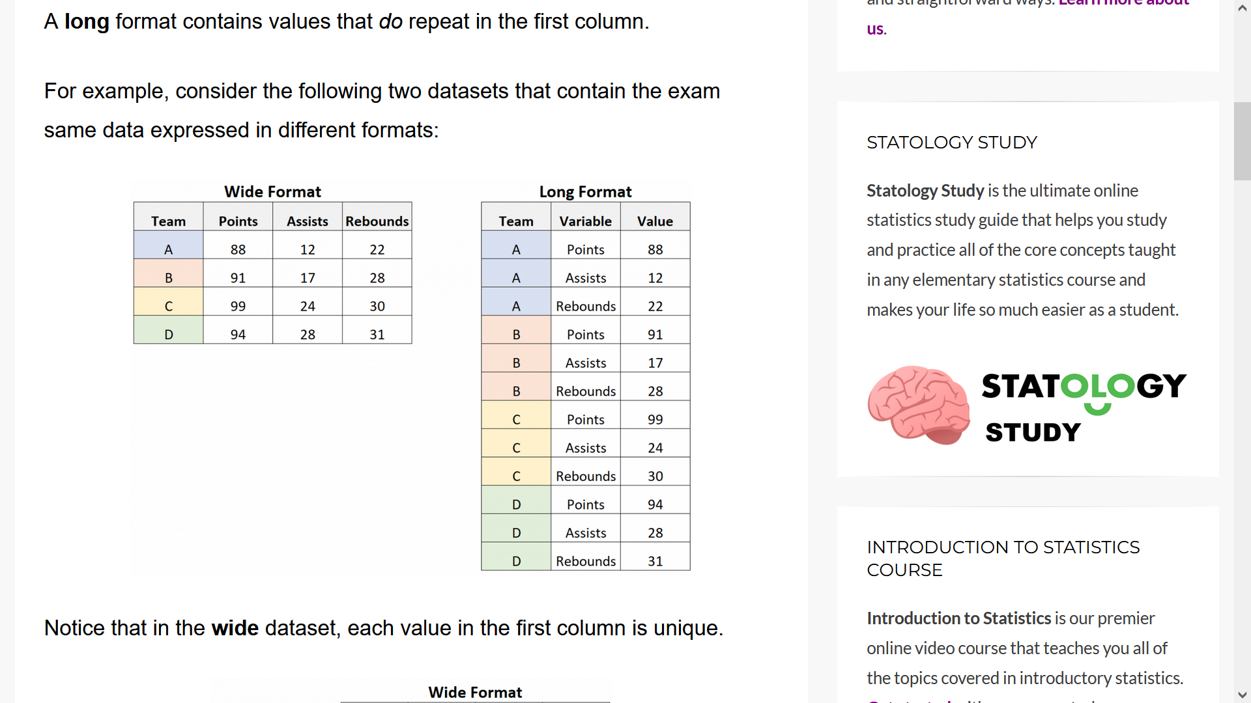
Reshaping I
There are two basic data formats
Wide is easier for your brain, as you can see columns side by side and compare across different classes
It also makes some mathematical operations easier (e.g. summing columns together)
Long is required for plotting, as it consolidates all numbers into a single dimension
Reshaping is when you switch from wide to long, or vice-versa

Slide 16
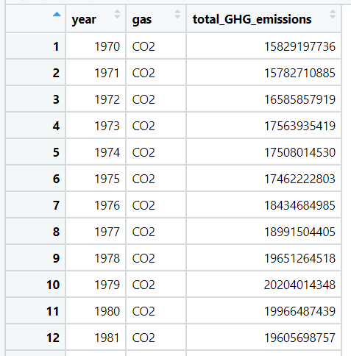
Reshaping II
Wide to long: gather()
Long to wide: spread()
plot_data_gases <- gather(plot_data_gases,key="gas",value="total_GHG_emissions",CO2:CO2_LULUCF)
For a gather operation, we need to specify the columns to gather, the key variable that captures the column names, and the value variable that captures the values

Slide 17
Mutating
Problem: we want to change a set of numbers, create a new variable, or perform a mathematical operation
“Mutate” allows you to select a column (or create a new one) and perform an operation on it.
E.g. divide by 1e9 to turn the units from t CO2eq to Gt CO2eq:
plot_data_gases <- plot_data_gases %>%
mutate(total_GHG_emissions=total_GHG_emissions/1e9)
Or e.g. sum two columns together:
plot_data_gases <- plot_data_gases %>%
mutate(new_column=column_a+column_b)

Slide 18
Filtering
Problem: we want to show a subset, rather than all of the data
“Filter” lets you apply conditions to your data frame, removing all rows that don’t meet them
E.g. remove rows with the year “2020”
plot_data_gases <- plot_data_gases %>%
filter(year!=2020)
E.g. only keep rows that are the year “2020”
plot_data_gases <- plot_data_gases %>%
filter(year==2020)

Slide 19
Plotting I
ggplot is the plot function in tidyverse
It follows a similar style and format as the coding we have seen so far: sequences of operations that layer up plot elements
Instead of %>% ggplot uses +
There are two key plotting concepts here: aesthetics and geometric objects
Aesthetics link your variables to visual elements on the plot. Using „aes()“ you can define:
x axis variable
y axis variable
colour
fill
other dimensions that are specific to certain plots (shape, size, xmin, xmax, …)

Slide 20




Plotting II
Geometric objects are the marks on the plot
There are many different geom functions (https://ggplot2.tidyverse.org/reference/)
Ones that I often use:
geom_area() # Area plot
geom_point() # Dot plot
geom_path() # Line plot
geom_bar() # Bar plot

Slide 21
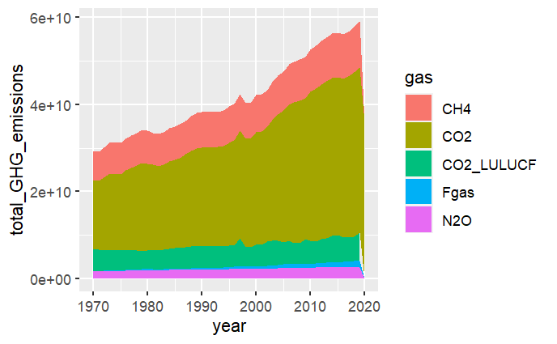
Plotting III
Define the aesthetics and choose a geom function: you have a plot!
ggplot(plot_data_gases,aes(x=year,y=total_GHG_emissions,fill=gas)) +
geom_area()
Next week we will learn a bit more on how to adjust your plot and make it look nice

Slide 22
How a data pipeline looks
Gather
plot_data_gases <- gather(plot_data_gases,key="gas",value="total_GHG_emissions",CO2:CO2_LULUCF)
plot_data_gases <- plot_data_gases %>%
filter(year!=2020) %>%
mutate(total_GHG_emissions=total_GHG_emissions/1e9))
ggplot(plot_data_gases,aes(x=year,y=total_GHG_emissions,fill=gas)) +
geom_area(color="#636363") +
ylab("Total GHG emissions (GtCO2eq)") +
theme_bw() +
scale_fill_brewer(palette="Set2") +
theme(axis.title.x = element_blank()) +
ggtitle("Total anthropogenic GHG emissions continue to grow")
library(tidyverse)
library(readxl)
data_ghg <- read_excel('Data/essd_ghg_data_gwp100.xlsx', sheet = 3)
data_lulucf <- read_excel('Data/essd_lulucf_data.xlsx', sheet = 2)
plot_data_gases <- data_ghg %>%
group_by(year) %>%
summarise(CO2=sum(CO2,na.rm=TRUE),
CH4=sum(CH4,na.rm=TRUE),
N2O=sum(N2O,na.rm=TRUE),
Fgas=sum(Fgas,na.rm=TRUE))
plot_data_lulucf <- data_lulucf %>%
group_by(year) %>%
summarise(CO2_LULUCF=sum(mean,na.rm=TRUE))
plot_data_gases <- left_join(plot_data_gases,plot_data_lulucf,by="year")
Filter & mutate
Load
Group
Plot
Join

Slide 23
Tasks for next week
Go through the workbook line by line, observe how the data frames change with each operation
Try doing a different join (right_join, full_join). What happens?
Can you re-shape the dataset back to a wide format?
Can you sum together columns to calculate total GHG emissions?
Can you change the area plot to a bar plot?

